Slide 1
Statistics FOR data science project UE19CS203
DIABETES: DATA ANALYSIS AND HYPOTHESIS TESTING

Slide 2
INTRODUCTION
Diabetes is a condition that impairs the body’s ability to process blood glucose, otherwise known as blood sugar. Over 30 million have now been diagnosed with diabetes in India. The estimate of the actual number of diabetics in India is around 40 million.
Diabetes is also beginning to appear much earlier in life in India, meaning that chronic long-term complications are becoming more common. The implications for the Indian healthcare system are enormous.

Slide 3
DATASET
The following dataset will help us predict whether or not a patient has diabetes, based on certain diagnostic measurements included in the dataset and to find out the factors which largely cause the condition.
All patients in the dataset are female.

Slide 4
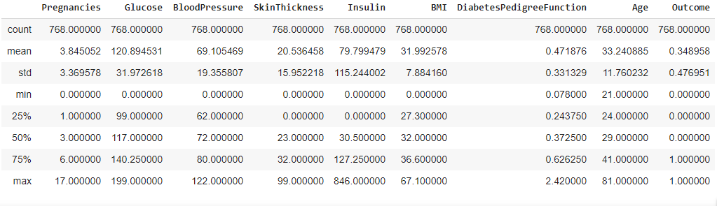
DATASET
Source : https://www.kaggle.com/uciml/pima-indians-diabetes-database
No. of rows=768
No. of columns=9

Slide 5
ATTRIBUTES
Pregnancies: Number of times pregnant
Glucose: Plasma glucose concentration over 2 hours in an oral glucose tolerance test
BloodPressure: Diastolic blood pressure (mm Hg)
SkinThickness: Triceps skin fold thickness (mm)
Insulin: 2-Hour serum insulin (mu U/ml)
BMI: Body mass index (weight in kg/(height in m)2)
DiabetesPedigreeFunction: Diabetes pedigree function (a function which scores likelihood of diabetes based on family history)
Age: Age (years)

Slide 6
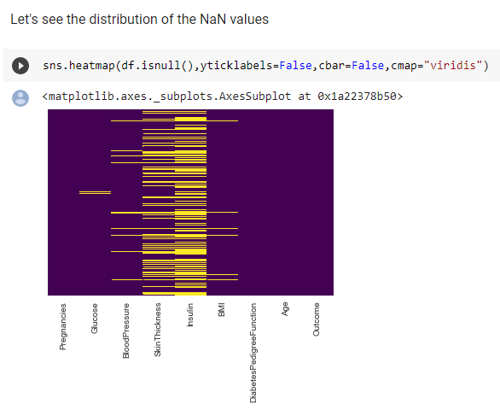
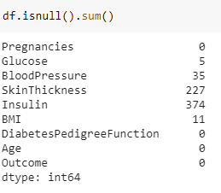
BEFORE CLEANING DATA

Slide 7
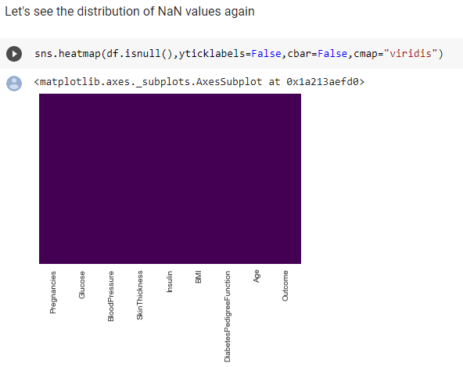
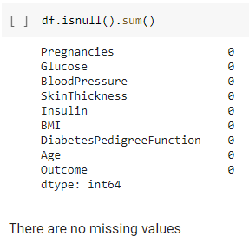
AFTER CLEANING DATA

Slide 8
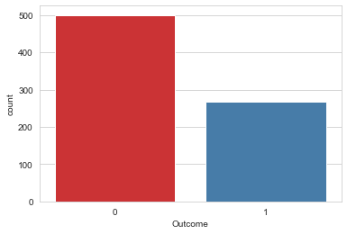
DATA VISUALISATION
INSIGHTS
500 patients are healthy while 268 patients have been diagnosed with diabetes

Slide 9
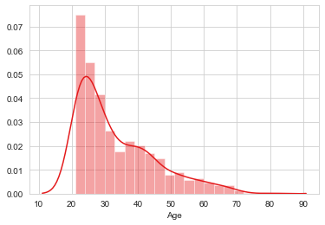
DATA VISUALISATION
INSIGHTS
Most of the patients in this dataset are in the age group of 20 to 30 years, with the minimum age as 21 years

Slide 10
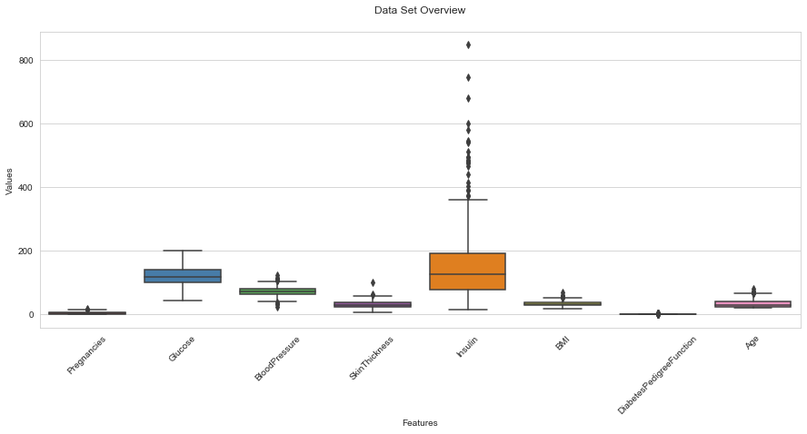
DATA VISUALISATION
INSIGHTS
From above plot we can see that there are outliers in the data and those outliers might be valid values so we can't replace the missing values with the mean( since the mean is heavily affected by outliers but median is not). Instead we will use the median by target to replace the missing data to get a much more realistic data.

Slide 11
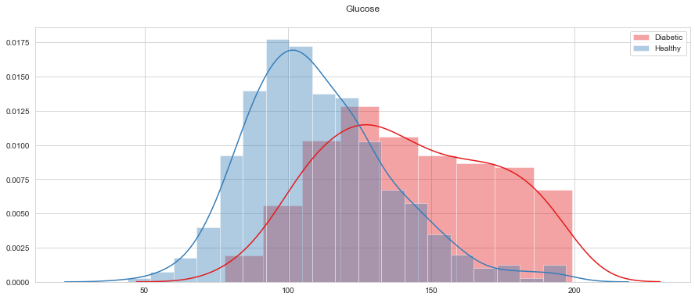
DATA VISUALISATION
INSIGHTS
From the above graph, we saw 107 Plasma glucose concentration level for non diabetic patients and 140 for diabetic patients

Slide 12
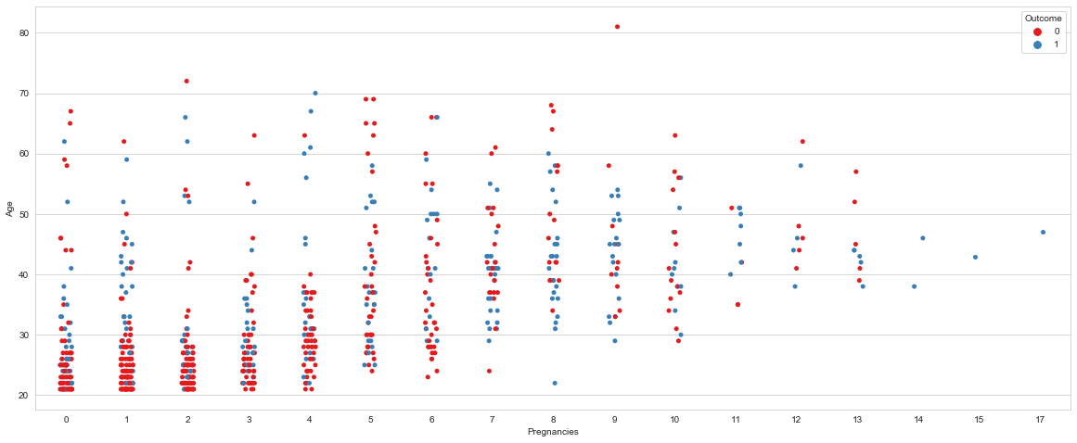
DATA VISUALISATION
INSIGHTS
Healthy patients are concentrated with Age <= 30 and Pregnancies <= 6

Slide 13
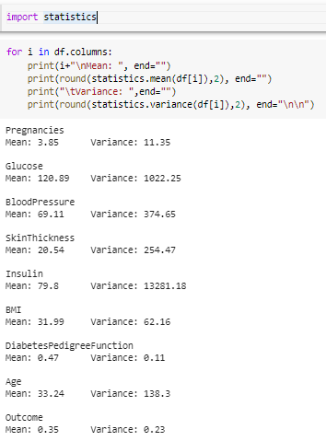
NORMALIZATION AND STANDARDIZATION
Normalization:-
Normalization is a part of the process of data preparation
for machine learning. The aim of normalization is to change
the values of numeric colums in the dataset to a common
scale, without distorting differences in the range of values.
It is necessary only when features have different ranges.
Normalization rescales the values into a range of [0,1].
Standardization:-
It rescales values to make its mean 0
and its standard deviation equal to 1.

Slide 14
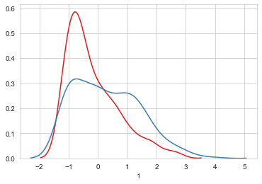
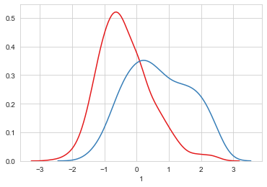
NORMALIZATION AND STANDARDIZATION GRAPHS
Pregnancies
Glucose

Slide 15
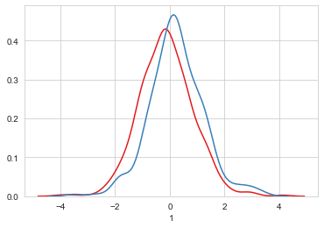
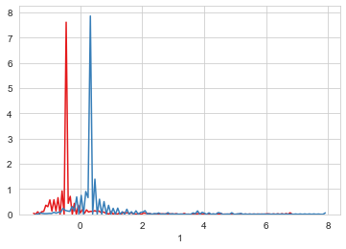
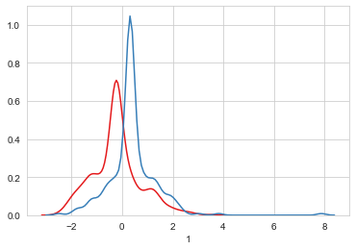
NORMALIZATION AND STANDARDIZATION GRAPHS
BloodPressure
Insulin
Glucose

Slide 16
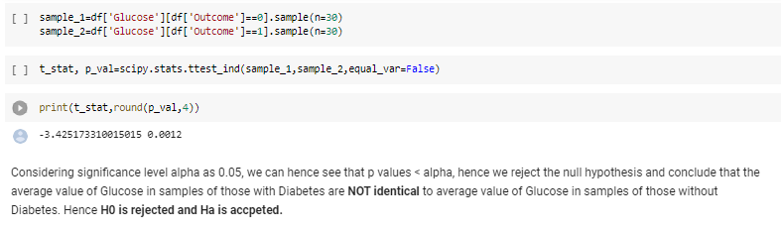
HYPOTHESIS TESTING
Research hypothesis
Null hypothesis H0: 2 independent samples of Glucose (grouped by whether patient is Diabetic or not) have identical average (xbar1 = xbar2)
Alternative hypothesis Ha: 2 independent samples of Glucose (grouped by whether patient is Diabetic or not) have DO NOT identical average (xbar does not = xbar2)

Slide 17
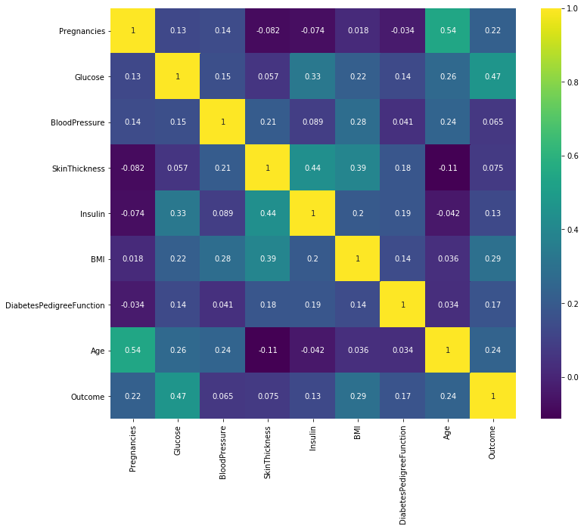
COrRELATION HEAT MAP

Slide 18
COrRELATION INSIGHTS
The highest correlation between the outcome and any one of the medical features is with glucose. This is obviously an overwhelmingly contributing factor in patients with diabetes.
The BMI and skin thickness also have a strong correlation indicating that the 2 are closely connected in terms of body fat content.
We know from basic biology that insulin regulates the usage of glucose in your body and the correlation between the 2 reflects that here as well.

Slide 19
ABSTRACT
The purpose of this statistical study was to investigate the occurrence of diabetes in a group of women in India typically around the age of 20-30 years with various medical features which include but were not limited to the number of pregnancies a woman has had, her age, her glucose concentration etc. The study was designed in such a manner so as to assess the degree of correlation between these features and diabetes and to infer and draw a conclusion from the data by visualising it using a variety of python tools and libraries. Within the study there were no major findings or trends unearthed that was previously unheard of in the study of diabetes. The study remained quite in tune with the medical knowledge in patients who have diabetes, for example, women with high values of BMI, skin thickness and insulin were more likely to have diabetes than those who did not have such high values. In short, the results can be summarised by inferring that older, unhealthy women make up most of the population of the group diagnosed with diabetes.

Slide 20
RESULTS AND CONCLUSIONS
It is observed that the insulin reading is the biggest determining factor of diabetes followed by the glucose reading. There are other factors that could possibly indicate the onset of diabetes such as high BMI’s and increased blood pressure among others. Hence, we can conclude that certain diagnostic measurements can show us signs of the possible onset of diabetes. If detected early on, changes can be made to lifestyle habits and timely medication can be prescribed, hence reducing the risk of major complications caused by diabetes.

Slide 21
THANK YOU

